Slide 1
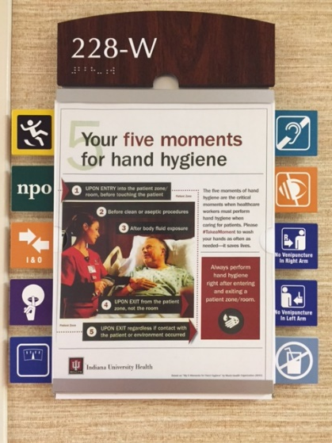
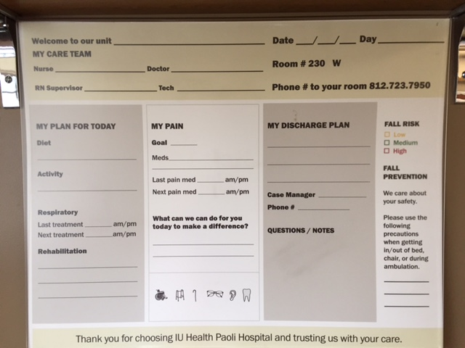
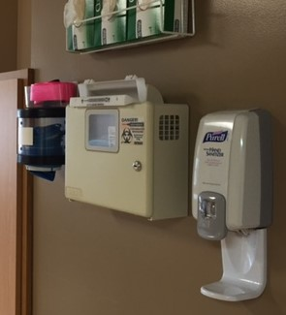
Walden University Doctorate of Nursing Practice Fall Safety Bundle Tool Kit
Baili D. Campbell DNP, RN
Purpose Statement
Project Goal and Outcomes
Project Results
The purpose of this DNP project was to develop an evidence-based fall safety bundle for use by nursing staff and an education curriculum to increase staff awareness and knowledge for prevention of falls and fall related injuries.
Project Goal
The project goal was to prevent patient falls and fall related injuries in the healthcare system.
Project Outcomes
Develop a standard evidence-based fall bundle tool kit.
Develop an educational initiative including a curriculum plan, pre-test/post-test, and a power point presentation.
Develop a content validation index plan for the pre and post test items. This will be completed by three expert stakeholders.
System wide adoption of a standard Fall Prevention Policy and Procedure.
System wide adoption of the Fall Safety Bundle including seven standard pieces of work to be implemented on all inpatient and psychiatric units.
System wide auditing tool implementation to continuously audit the units standard work process during and after implementation.
A system wide adoption of a standard safe handoff tool, patient communication boards that includes toileting and fall risk/prevention identifiers, standardized safety equipment including gait belts, Posey alarms (bed, chair, and toilet), a standard post fall huddle form, and the same electronic fall risk identification tool (John Hopkins Fall Risk Tool).
Each standard of work piece has been implemented at all 17 hospitals within the IU Health Organization.
Project Statement
The problem identified was the number of patient falls per year which resulted in major and minor injuries or death and/or increased health care cost to the organization.
The healthcare system had a total of 1,605 patient falls in 2013 ranging from infant drops, falls on mother/baby units, inpatient units, and the emergency rooms.
Falls are the leading cause of injury-related death among patients age 65 or older (Halm & Quigley, 2011).
The increased number of falls costs the health care system billions of dollars each year. Hospitals are no longer being reimbursed for injuries related to falls which significantly impacts hospital finances leading to unnecessary cost and decreased reimbursement (Center for Medicare & Medicaid Services (CMS), 2014).
Fall Safety Bundle Took Kit
The Fall Safety Bundle Kit includes seven standard of work pieces. The standard pieces of work include:
Patient Communication Board
Toileting
Patient/Family Teaching
Safe Handoff Communication
Equipment
Daily Safety Huddle
Post Fall Huddle
Introduction
My Organization
Indiana University Health is Indiana's most comprehensive healthcare system. A unique partnership with Indiana University School of Medicine, one of the nation's leading medical schools, gives patients access to innovative treatments and therapies. IU Health is comprised of hospitals, physicians and allied services dedicated to providing preeminent care throughout Indiana and beyond.
Background
Adverse Outcomes
Falls Resulting in injury occur in 30% to 51% of patients.
Among those who fall, a major injury (fracture) occurs in 1% to 3%.
The health care system in question had a total of 1,605 patient falls in 2013 ranging from no injury to major injury.
As of 2008, the Centers for Medicare & Medicaid Services (CMS) does not reimburse for hospital related injuries.
Adverse Social Outcomes
Increased length of stay.
Fear of falling.
Loss of activity and strength due to fear of ambulation.
Authors Contact Information
Please contact student for further information or questions:
Baili D. Campbell DNP, RN
Indiana University Health
bcampbell3@iuhealth.org
812.723.7452

